Slide 1



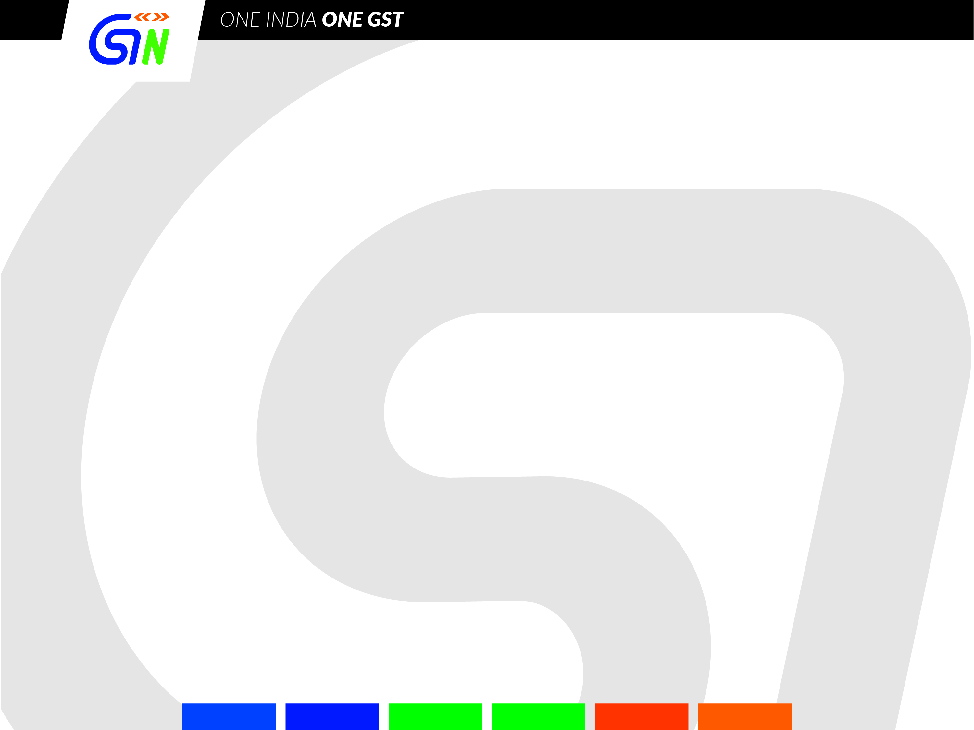
Introduction
to
GST ENFORCEMENT MODULE
(Back Office for Model-2 States)
Developed and Designed
by GSTN

Slide 2



Enforcement Module
The Enforcement Module tries to mimic the typical journey of an Enforcement Case electronically, right from the case creation stage to the issuing of a Show Cause Notice along with additional processes like enquiry from other departmental formations, case referrals from other modules like Audit, Assessment etc. and pre-GST offence history.
The idea here is that the manual/physical processes associated with an enforcement case file creation and its processing should give way to executing everything electronically, including the serving of notice to the Taxpayer.
Developed and Designed
by GSTN

Slide 3
A Few Pointers
Developed and Designed
by GSTN

Slide 4
A Few Pointers…
Module rolled out on 24th July, 2019
Handbook on Enforcement shared with all model-2 States
Provision for Cross-Empowerment – within State
Pan India record search functionality
Intra and Inter-State/Centre co-ordination possible through Inquiry-Response Functionality in the Module
Module is being extensively used by most of the Model-2 States
Developed and Designed
by GSTN

Slide 5
Design Elements
Developed and Designed
by GSTN

Slide 6
Design Elements…
3 User Types
Supervisory Officer
Case monitoring &
approving authority
Enforcement Officer
Case creation & case
execution officer
Secondary User 1
Secondary User 2
Case assistance officer (restricted access)
Other jurisdictional officer for enquiry redressal (restricted access)
Developed and Designed
by GSTN

Slide 7
Design Elements…
Case Management:
      2 broad categories of cases- Goods in Transit & Other than those in transit
      Case assigned to one officer at a time.
      Any case at any stage can be transferred to other enforcement officer/ module.
      The officer to whom Enforcement officer refers enquiry, may book a case afresh, in case of a major finding against related taxpayers.
Prioritization of cases :
      Case listings based on precise status of the current stage of a case.
      Notifications in ‘My Tasks’.
      MIS Reports on Enforcement.
Record Search functionality:
      Officer may access GSTIN wise records and offence history of all cases against a specific GSTIN for the entire state.
      View All India Records role provided for accessing All-India GST data of taxpayers.
      A log of such data access is maintained in system and alert is sent to the jurisdictional Commissioner of tax officer(who initiated the request) and taxpayer (for whom the request was initiated).
Developed and Designed
by GSTN

Slide 8
Design Elements…
Case creation:
      General layout is same for types of cases; various tabs are intuitively placed based on the underlying functionality.
      Unique Case ID generated for each case.
      Unique reference no. generated for each document.
      Any Enforcement officer within a state may create a case ID against any taxpayer, irrespective of jurisdiction (Centre/State) in the same state.
      Facility to build historical database of Pre-GST offence details against a particular GSTIN (booked in pre-GST regime under earlier laws)
      Enquiry, both intra & inter-State/Centre can be raised prior to or after creation of Case ID, against any taxpayer.
Forms:
      All statutory INS forms, MOV forms (as per Circular) and other useful forms are provided in the module (generated with a unique Ref. No.)
      In all forms, the facility for attachment is provided - useful for uploading any document/information which otherwise could not be captured/ entered on screen. (Max. 4 attachments in JPEG/PDF & each 5 MB max.)
      Built-in Validations to reduce chances of errors; at the same time, several non-mandatory fields are kept for system flexibility.
      All forms issued to a taxpayer are enabled with Digital Signature.
Developed and Designed
by GSTN

Slide 9
Process flows in Enforcement Module
Developed and Designed
by GSTN

Slide 10
In cases of Goods in Transit
Interception of Conveyance
Physical Verification
Report (MOV- 04)
Recovery
No discrepancy
found
Release Order
(MOV- 05)
Non- payment of liabilities
Case initiation (MOV- 01)
Discrepancy
found
On full payment of liabilities
Order for Physical Verification (MOV- 02)
Detention Order u/s 129(1)
(MOV- 06)
+
Notice for Tax & Penalty u/s 129(3)
(MOV- 07)
Beyond
3 days
Provisional Release Bond (MOV- 08)
Extension of time for physical verification
(MOV- 03)
Comes forward and makes payment
Within
3 days
Demand Order u/s 129 (3)
(MOV- 09)
Payment made within 15 days of receiving of MOV- 09 by the taxpayer
Physical Verification
Report (MOV- 04)
If 15 day limit breached
Notice for confiscation u/s 130
(MOV- 10)
Order for confiscation u/s 130
(MOV- 11)
Developed and Designed
by GSTN

Slide 11
In cases other than those of Goods in Transit
Case Closed
Case initiated
Authorization for inspection or search (INS- 01) u/s 67(1)
Liability owed is intimated to the assessee (DRC-01A) which is then payed by DRC-03 and acknowledged by DRC- 04 u/s 73(5)/74(5)
Assessment Module
Search/Inspection carried out and panchnama drawn
Voluntary payment by the assessee (DRC- 03) and acknowledged by the enforcement officer (DRC- 04)
Show cause notice u/s 73/74
Material evidence seized by way of order of seizure (INS- 02) u/s 67(2)
Unseized goods may be prohibited to be removed by way of Order of prohibition (INS- 03)
Developed and Designed
by GSTN

Slide 12
Performing Key Steps in Module
Developed and Designed
by GSTN

Slide 13
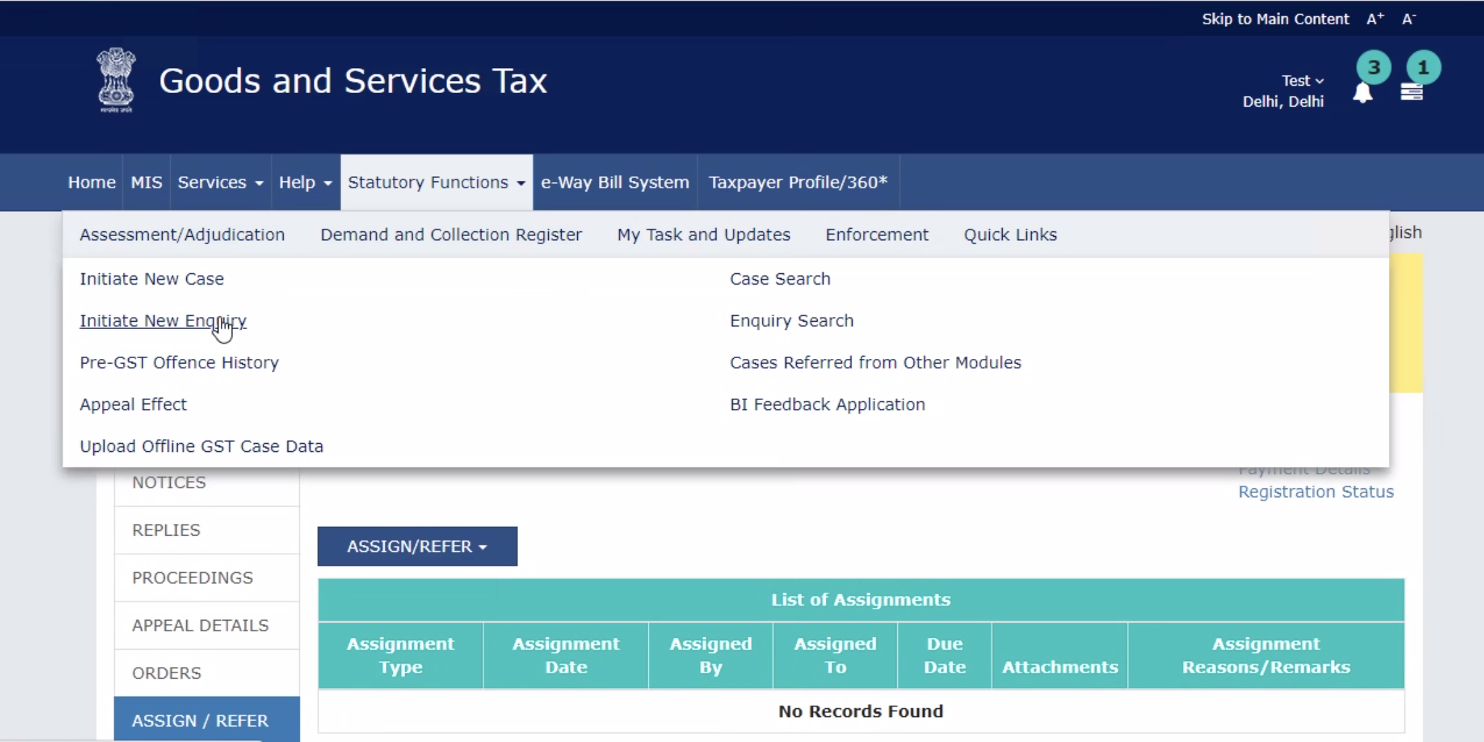
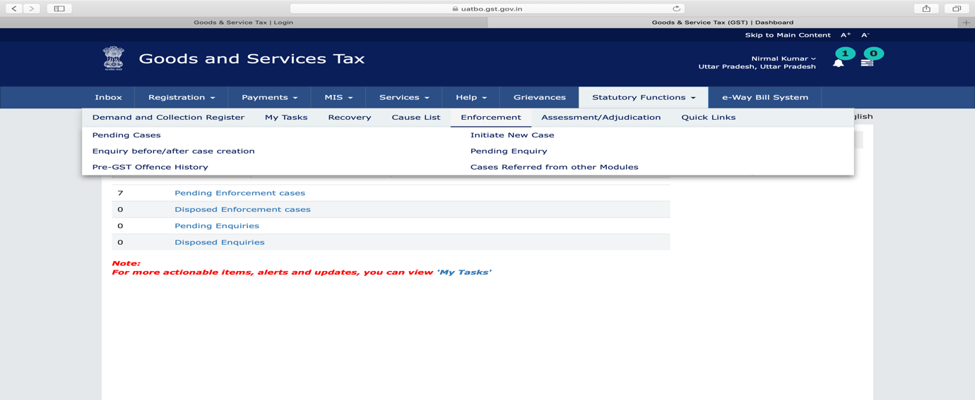
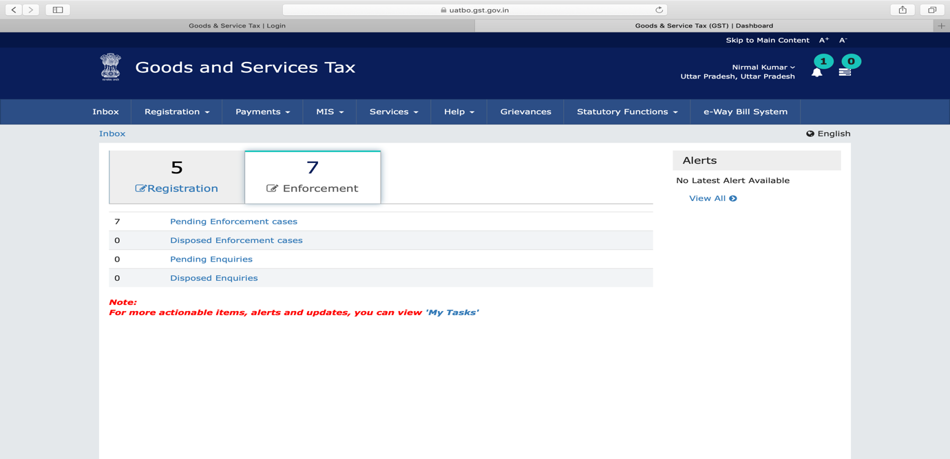
Login & dashboard of an enforcement officer
Developed and Designed
by GSTN

Slide 14
Creation Pre-GST offence history
Developed and Designed
by GSTN

Slide 15
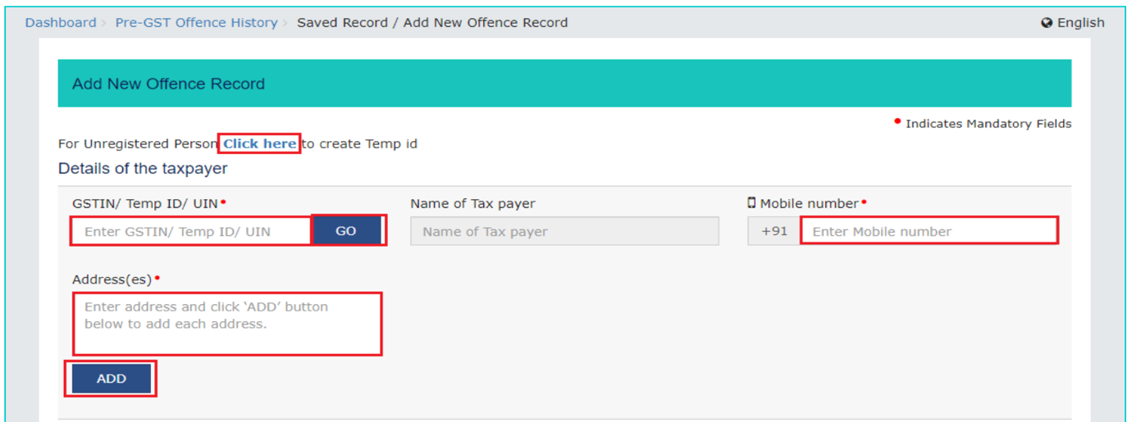
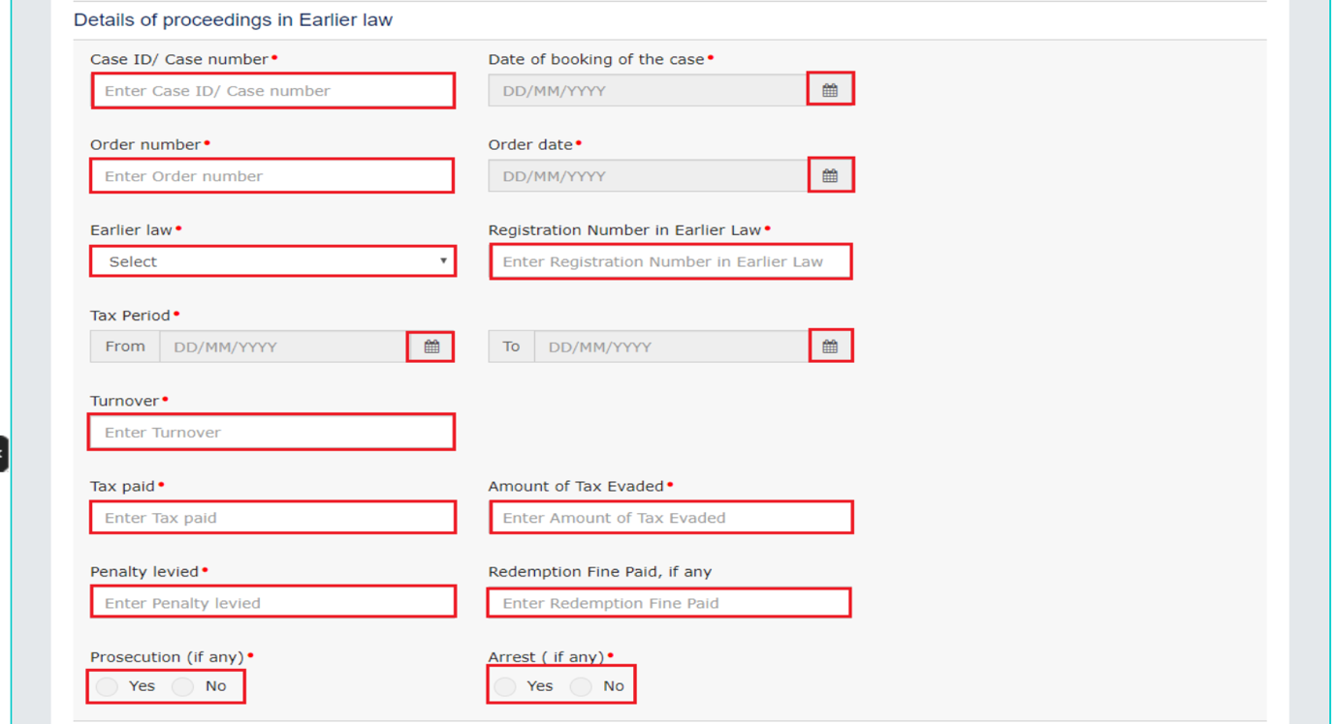
Adding/fetching Pre-GST offence history (Continued)
Developed and Designed
by GSTN

Slide 16
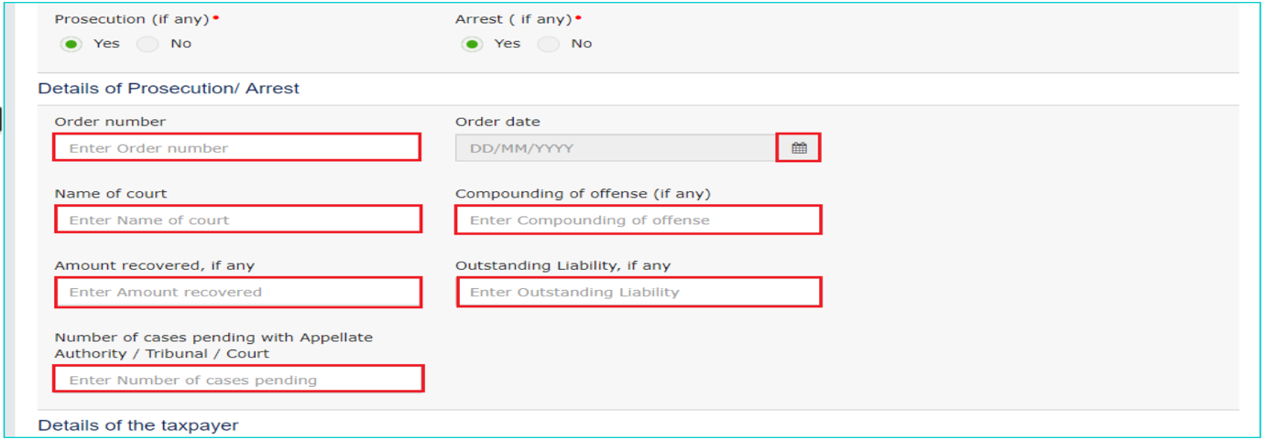
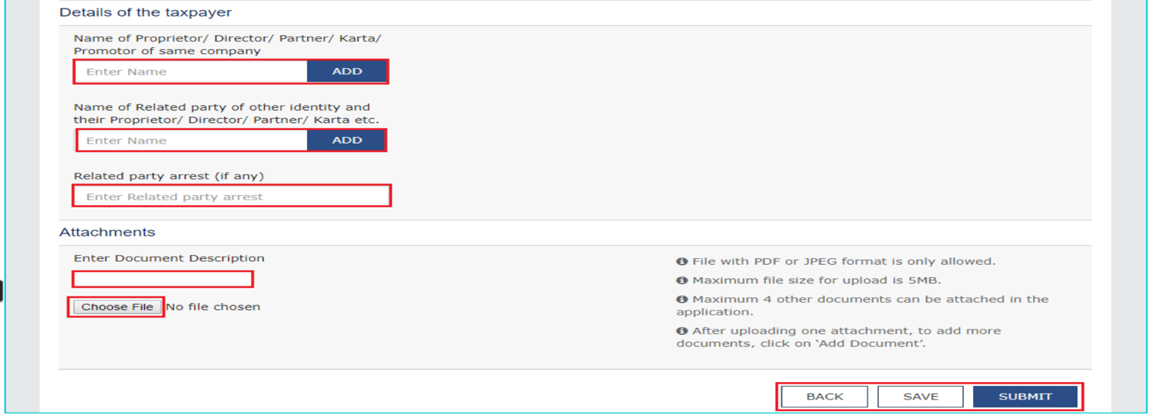
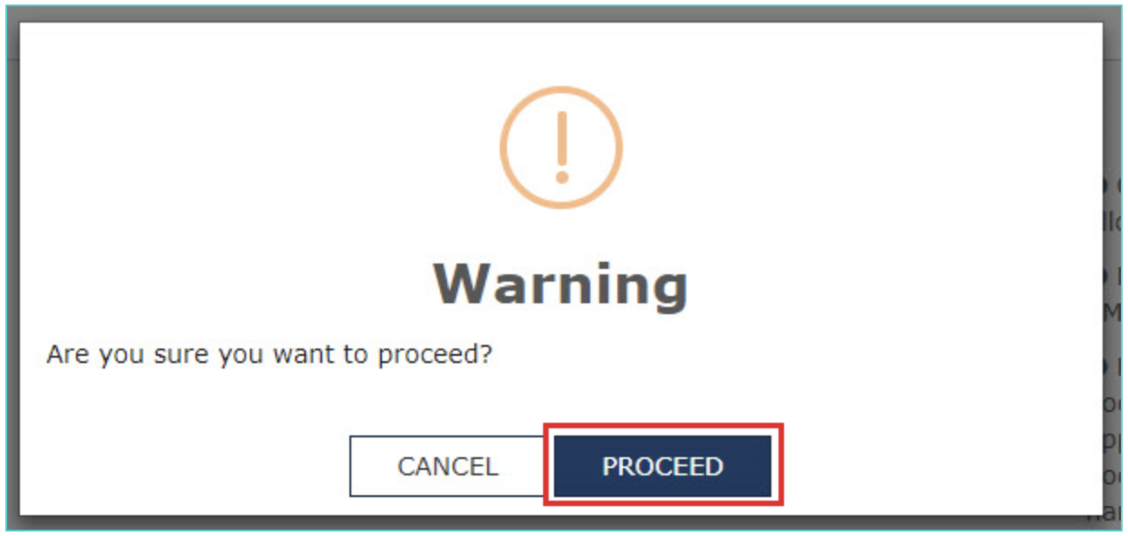
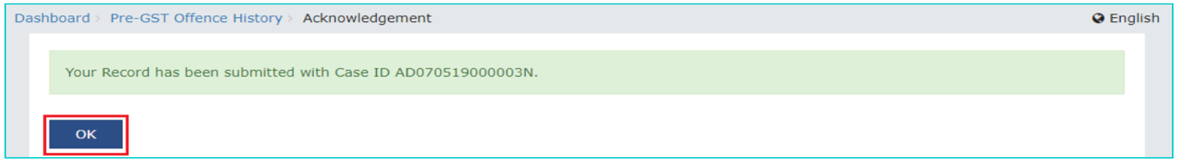
Adding/fetching Pre-GST offence history (Contd..)
Developed and Designed
by GSTN

Slide 17
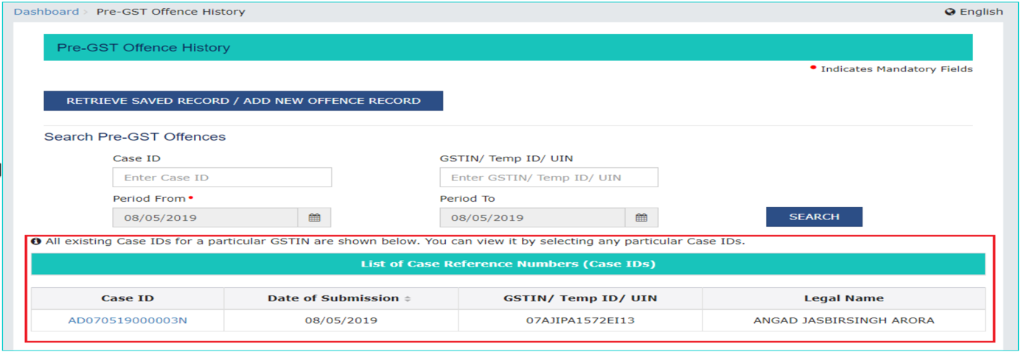
Fetching Pre-GST offence history (Contd..)
Developed and Designed
by GSTN

Slide 18
Enquiry referred to other jurisdictional officers
Seeking additional information from other Enforcement Officers within/outside the state regarding any taxpayer.
Developed and Designed
by GSTN

Slide 19
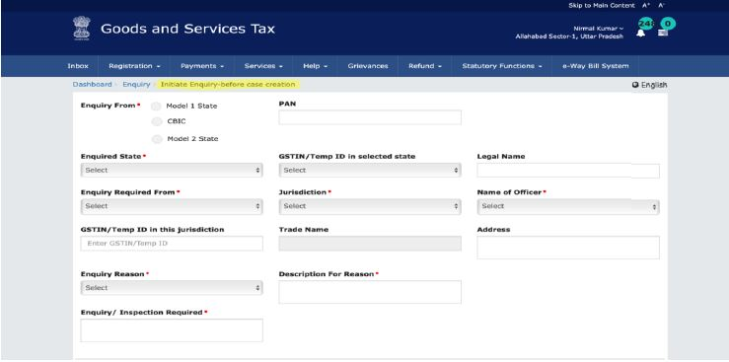
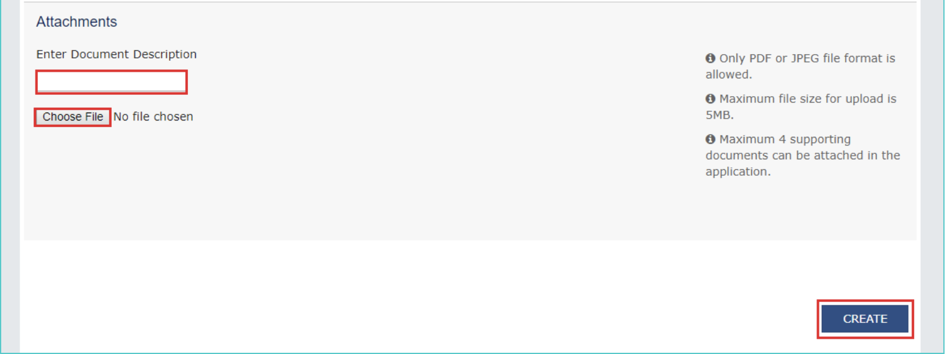
Enquiry referred to other jurisdictional officers
Developed and Designed
by GSTN

Slide 20
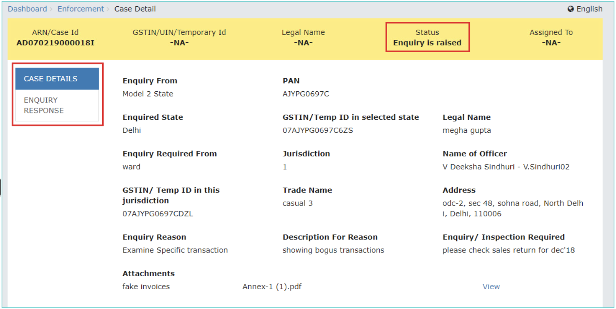
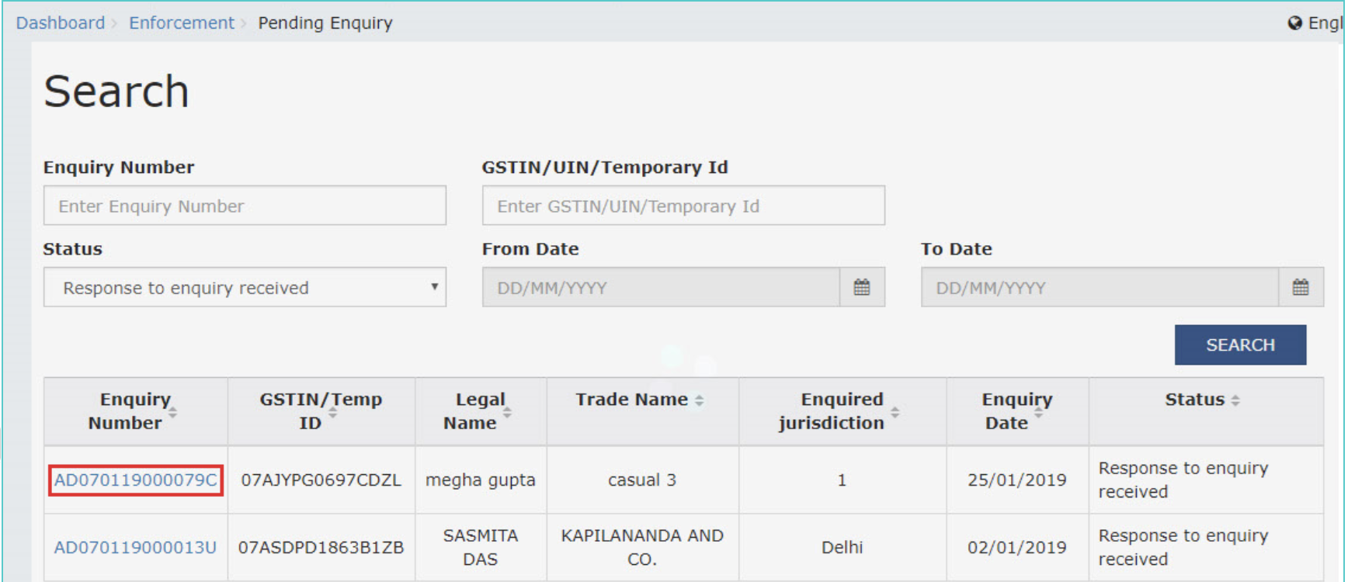
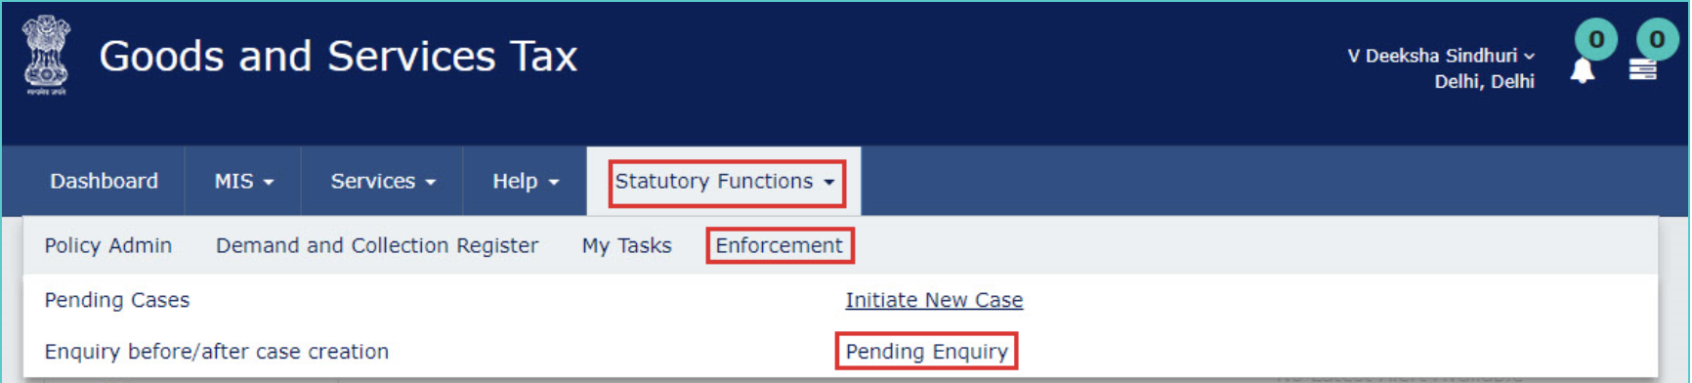
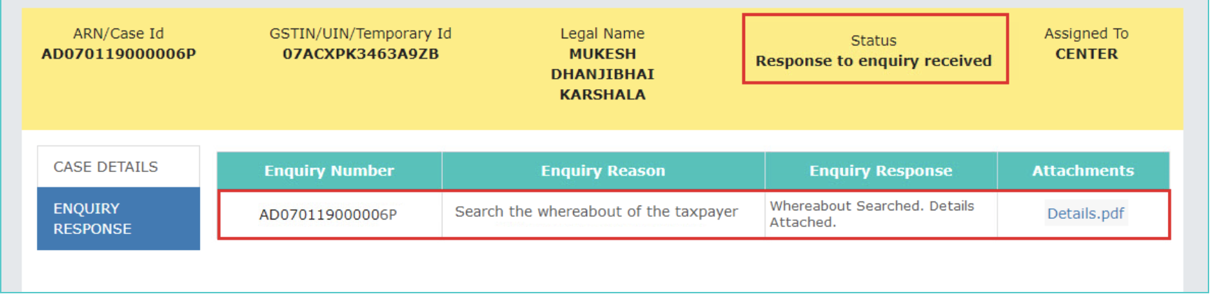
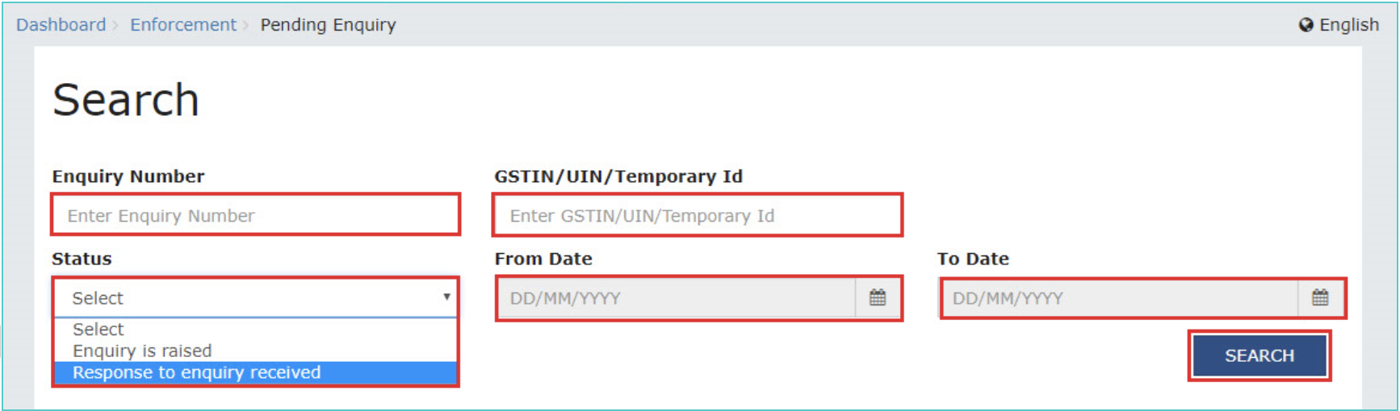
Enquiry referred to other jurisdictional officers
Enquiry Raised
Response of Enquiry Received
Enquiry is shown as Pending
Status of Enquiry
Developed and Designed
by GSTN

Slide 21
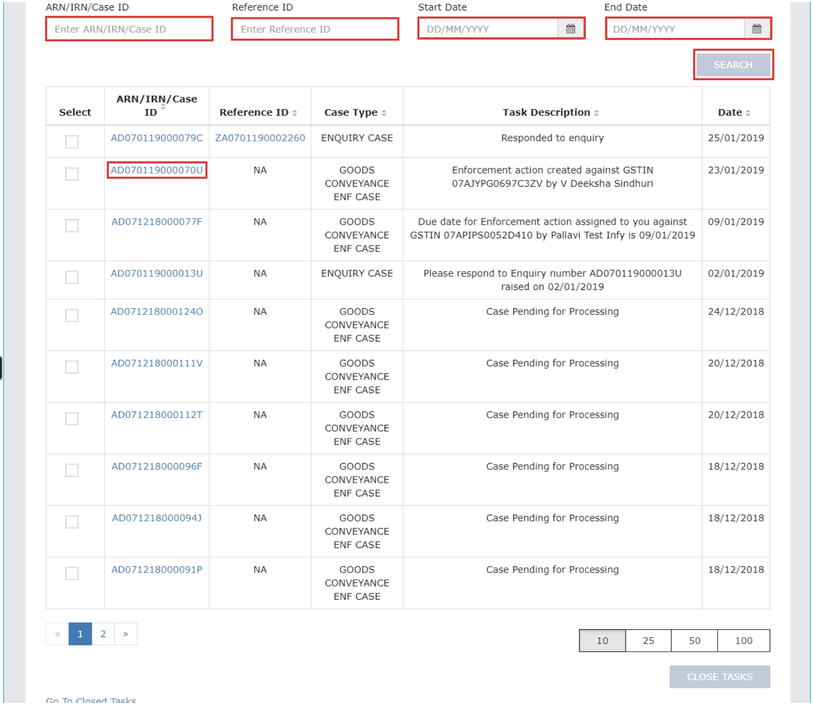
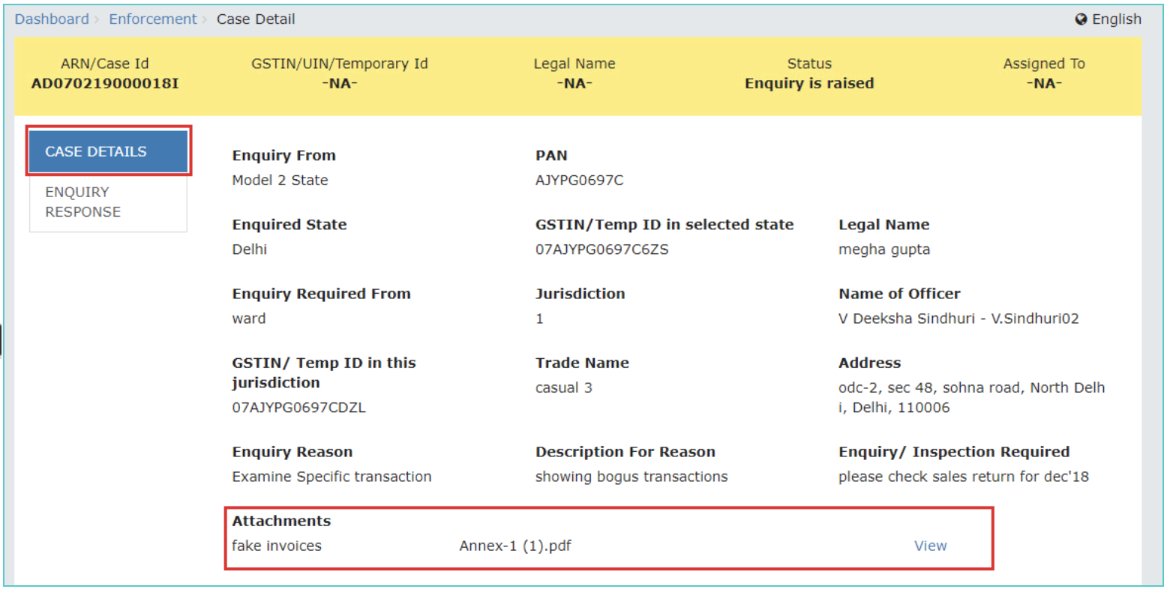
Enquiry: Other Jurisdictional officers’ Dashboard
Developed and Designed
by GSTN

Slide 22
Enquiry: Other Jurisdictional officers’ Dashboard
Developed and Designed
by GSTN

Slide 23
Enquiry: Other Jurisdictional officers’ Dashboard
Developed and Designed
by GSTN

Slide 24
Pending Cases
Developed and Designed
by GSTN

Slide 25
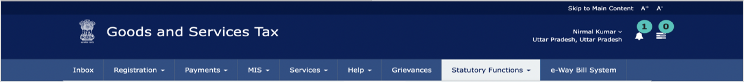
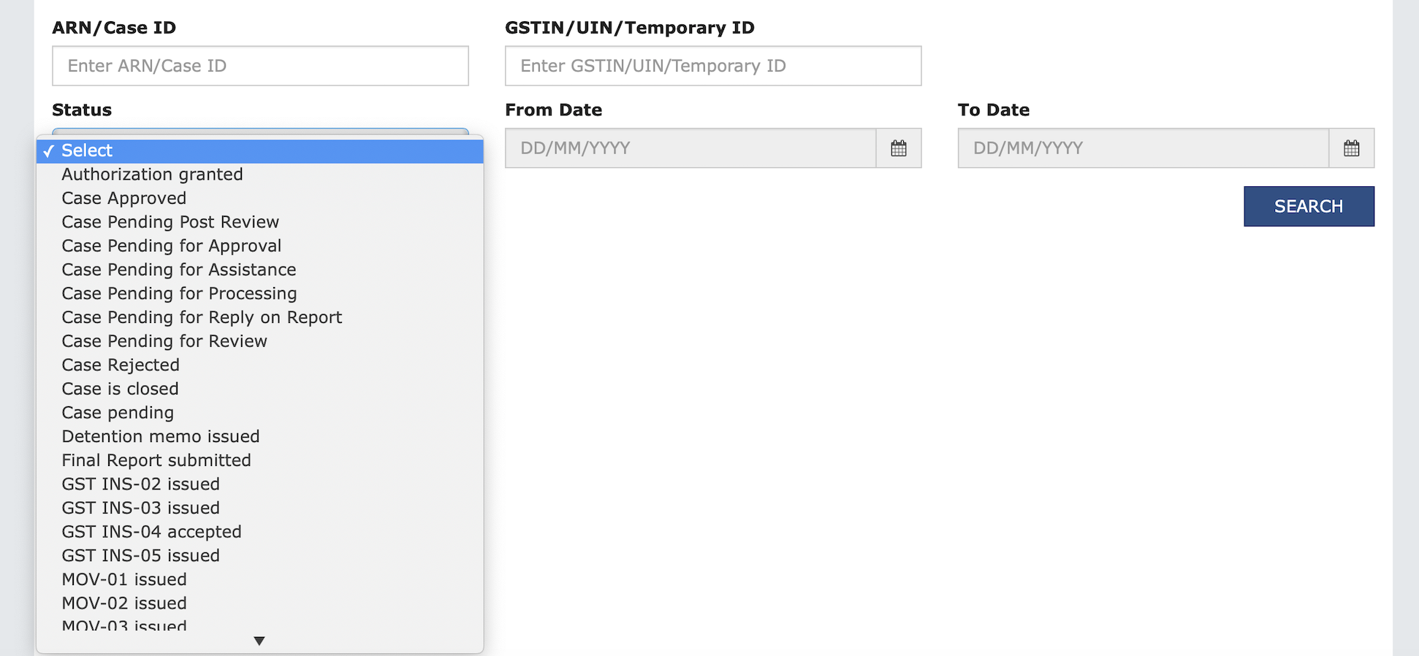
Pending Cases
You can check the precise status and search the relevant case IDs.
45 types of statuses.
Developed and Designed
by GSTN

Slide 26
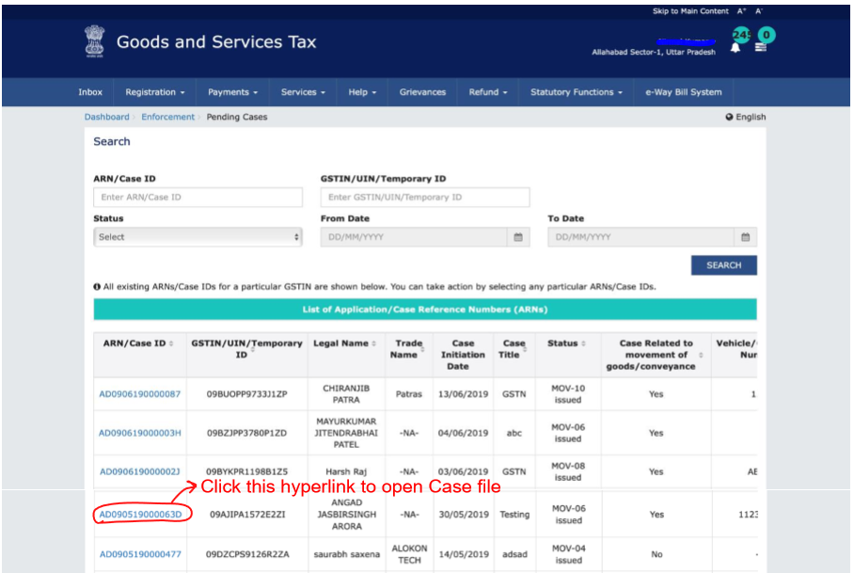
Pending Cases
Developed and Designed
by GSTN

Slide 27
Initiate New Case
Developed and Designed
by GSTN

Slide 28
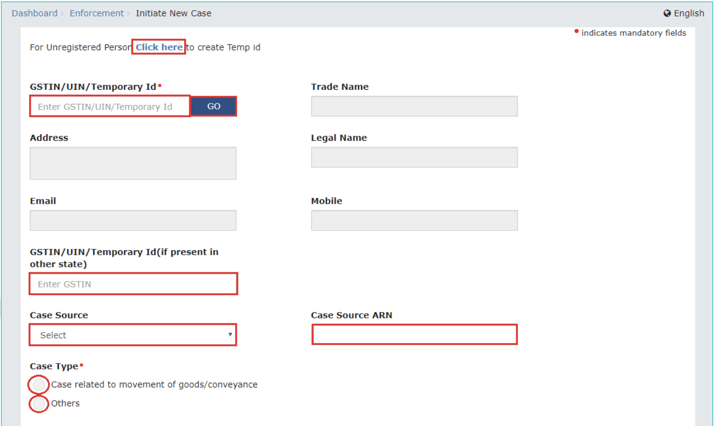
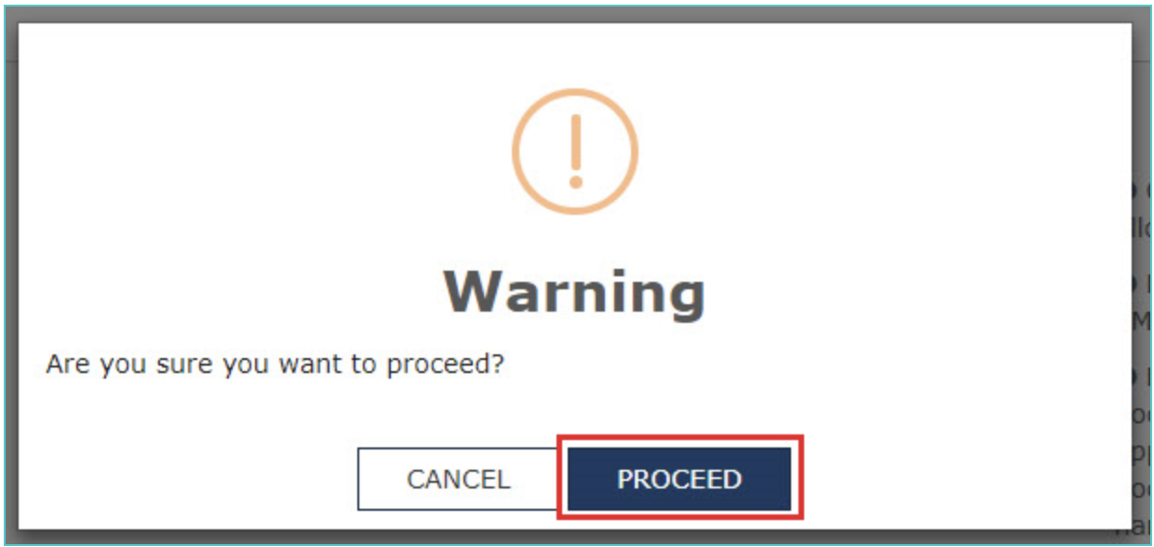
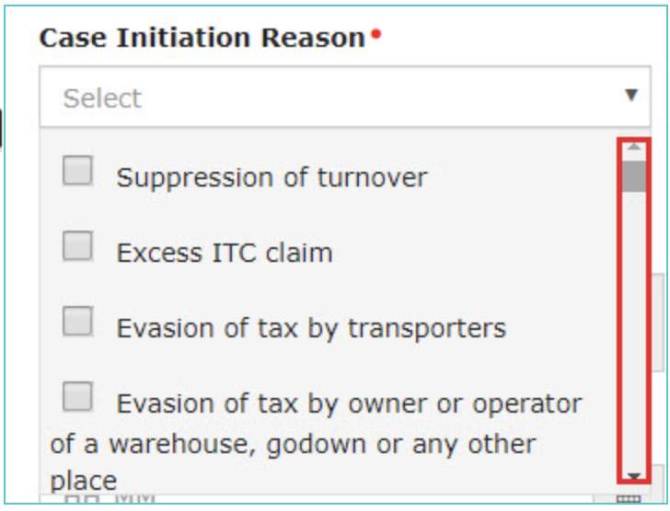
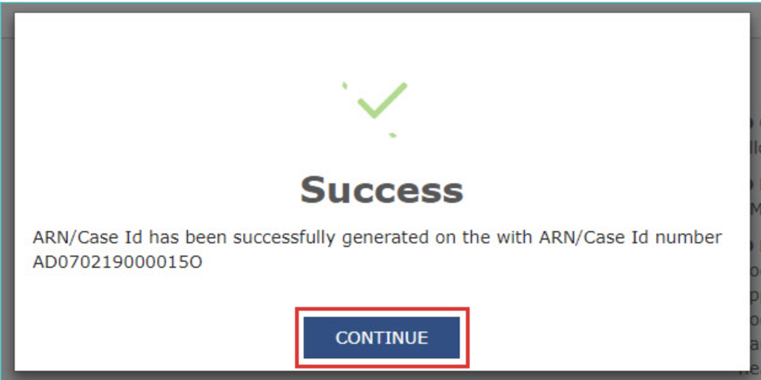
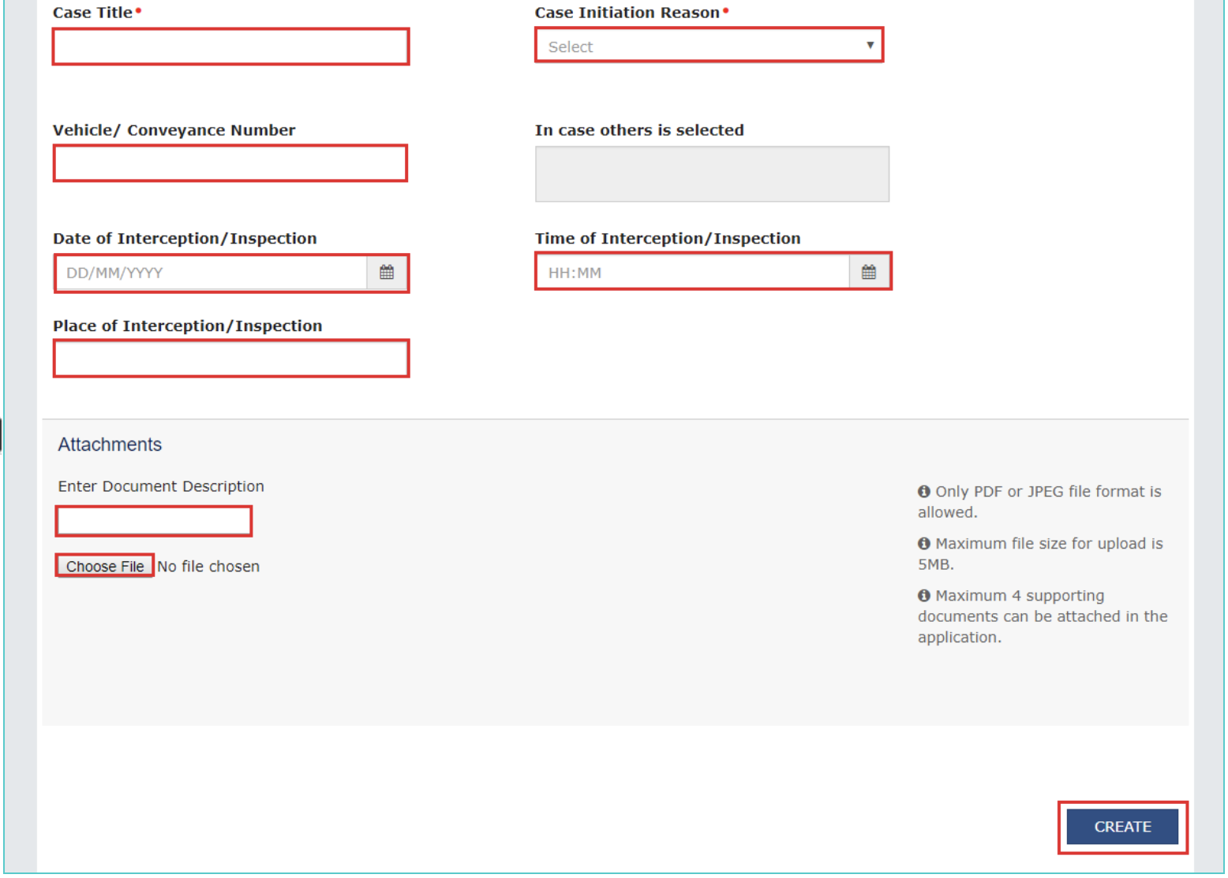
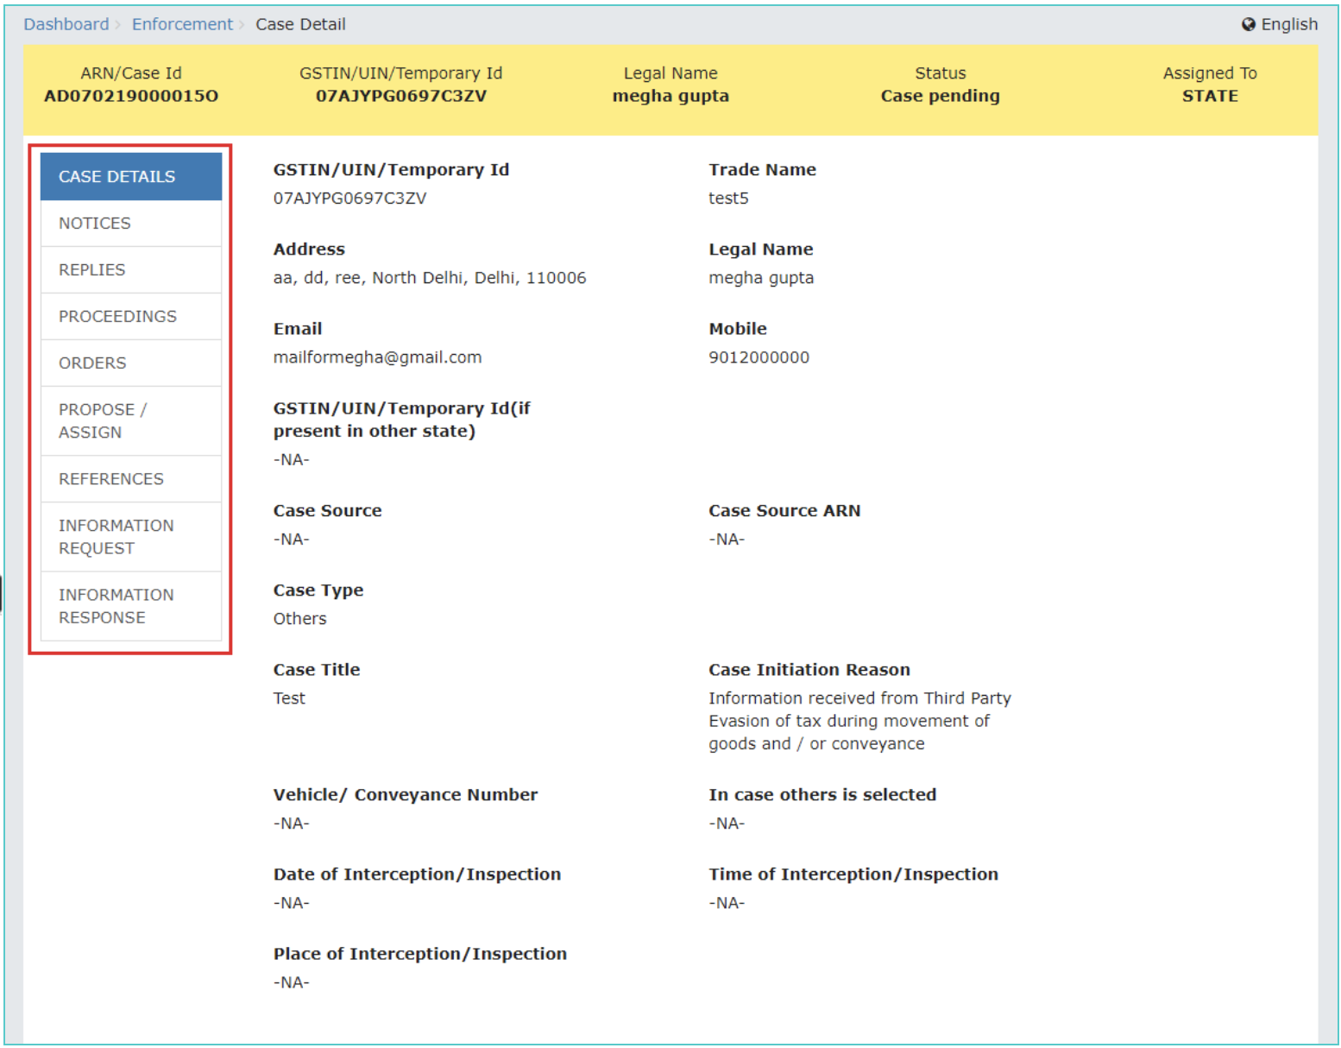
Creation of new Case ID (similar to opening new Case File)
Developed and Designed
by GSTN

Slide 29
Case File Opened
Developed and Designed
by GSTN

Slide 30
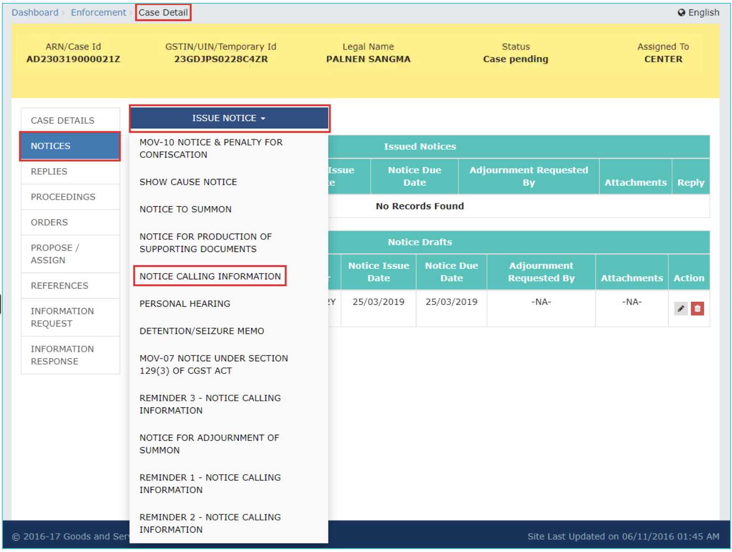
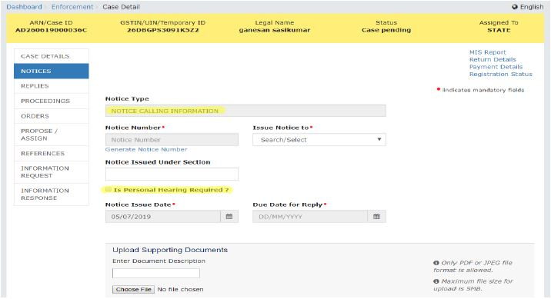
Notice calling for Information from taxpayers
Developed and Designed
by GSTN

Slide 31
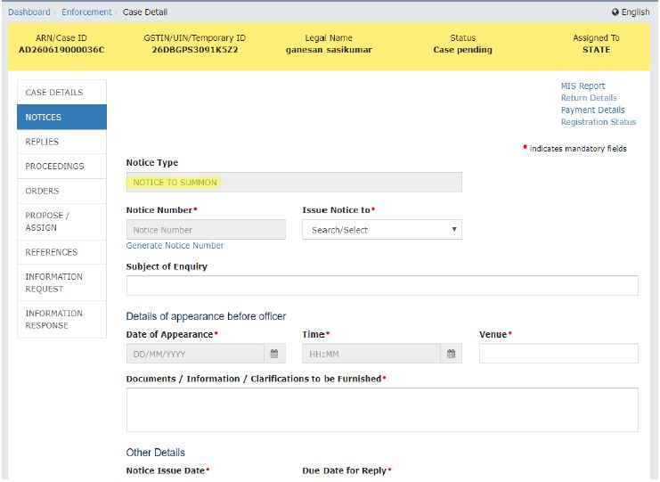
Issue Summon
Developed and Designed
by GSTN

Slide 32
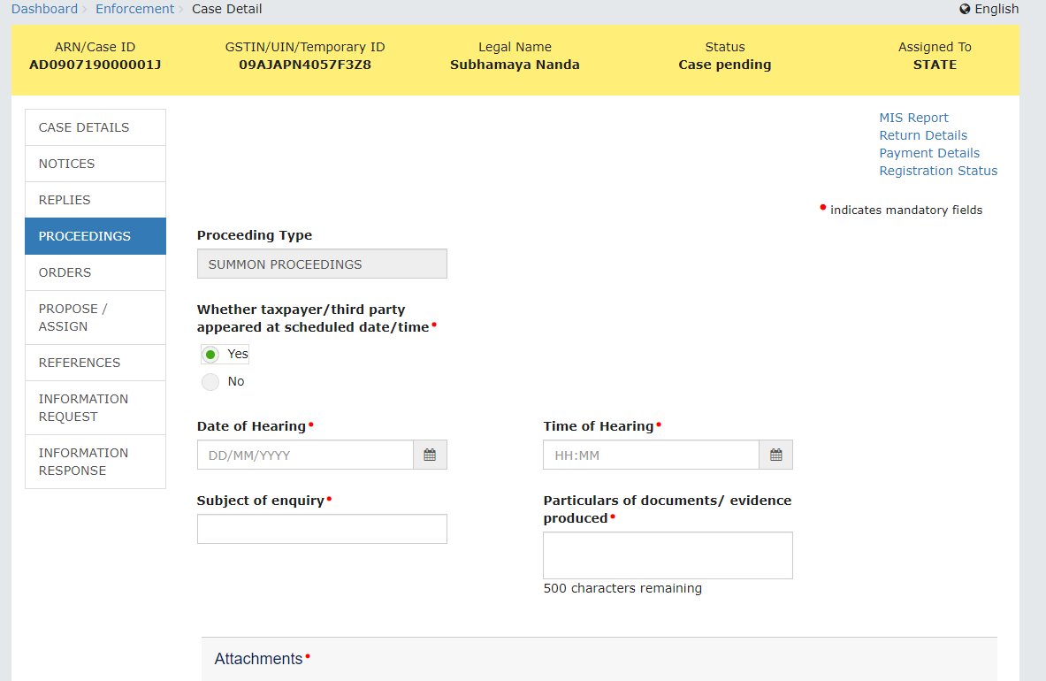
Record Statement / Summon Proceedings
Developed and Designed
by GSTN

Slide 33
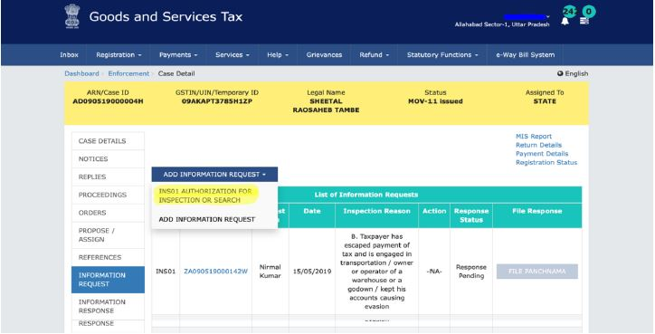
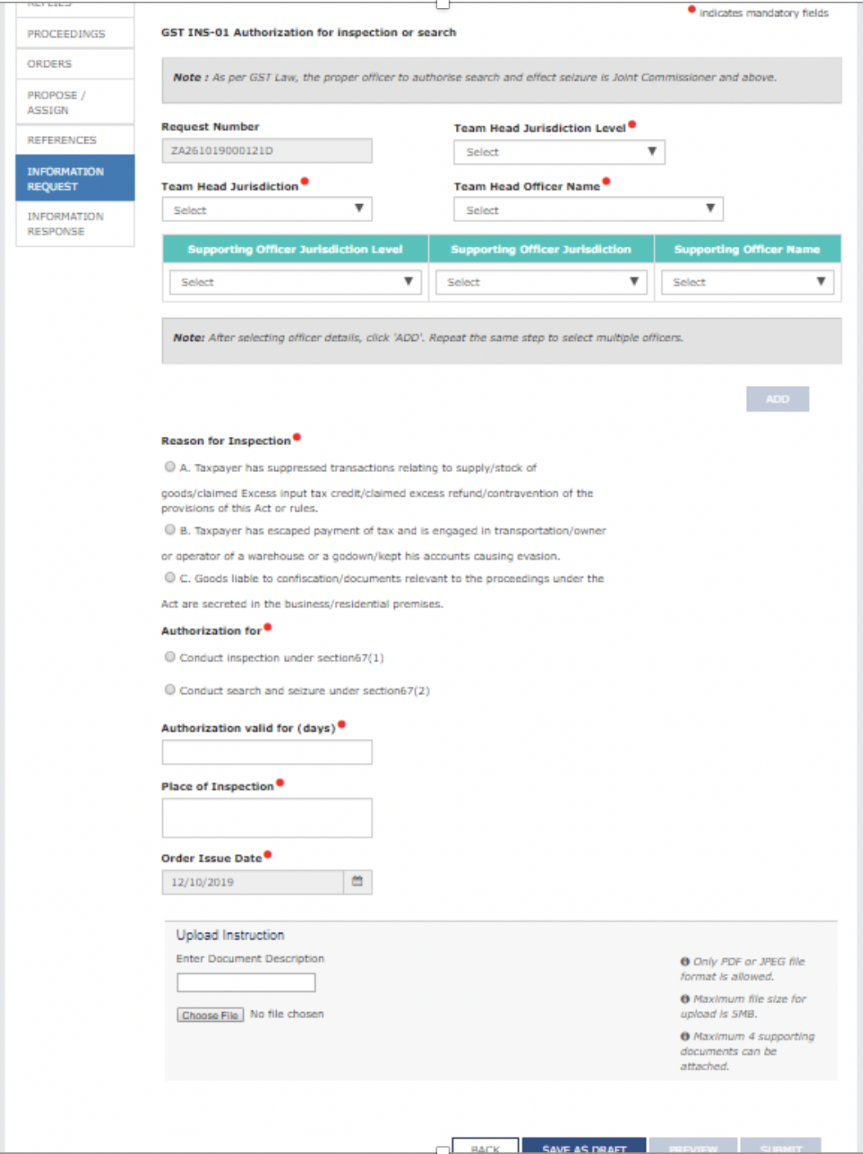
Inspection/Search at place of business (Section 67)
Developed and Designed
by GSTN

Slide 34
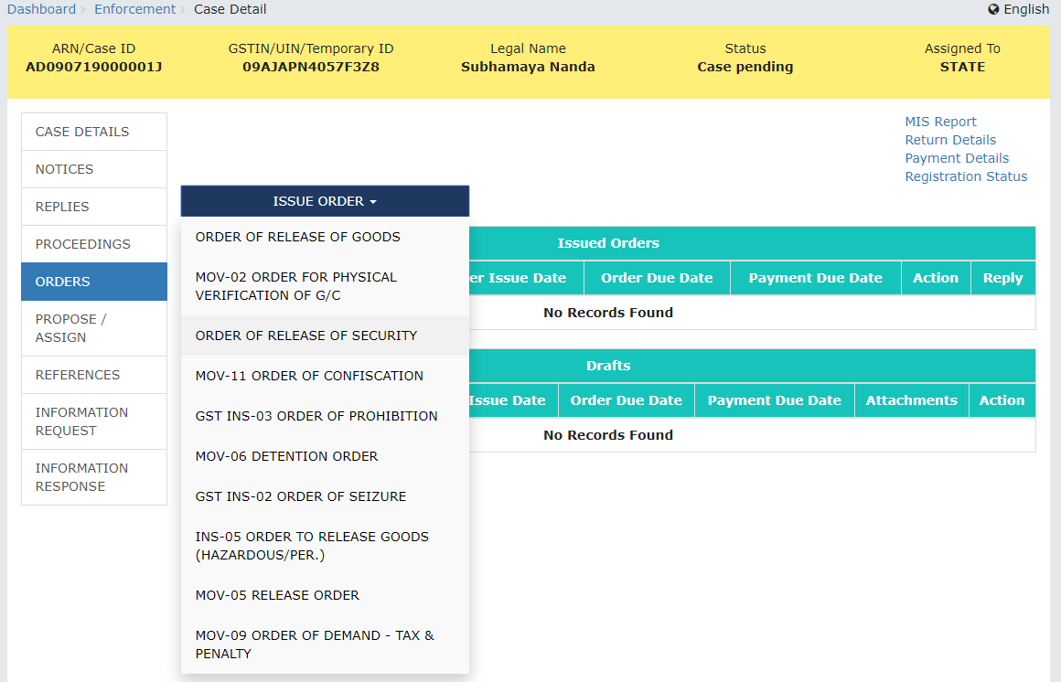
Detention, Seizure and Confiscation of Goods in Transit
(Section 68, 129/130)
Developed and Designed
by GSTN

Slide 35
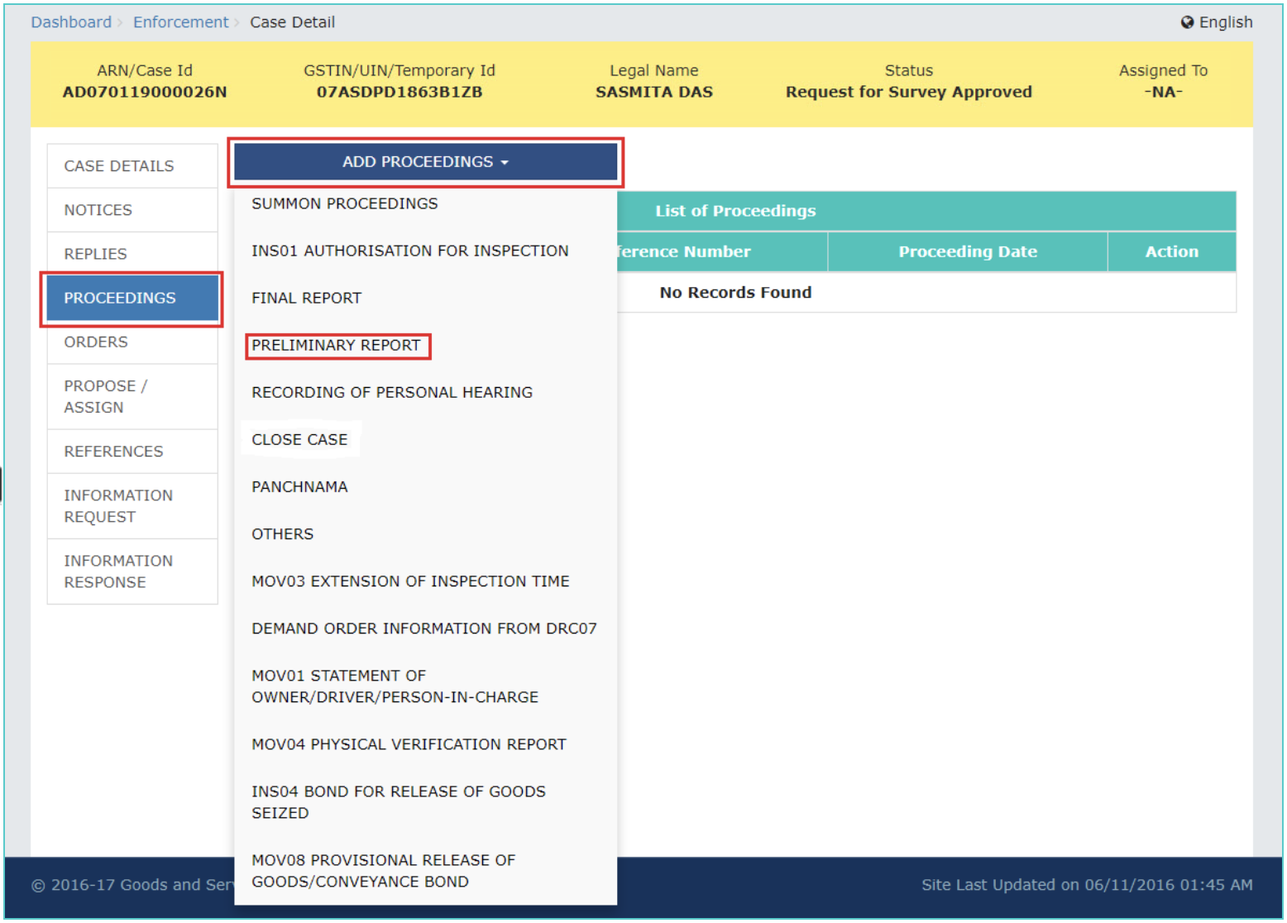
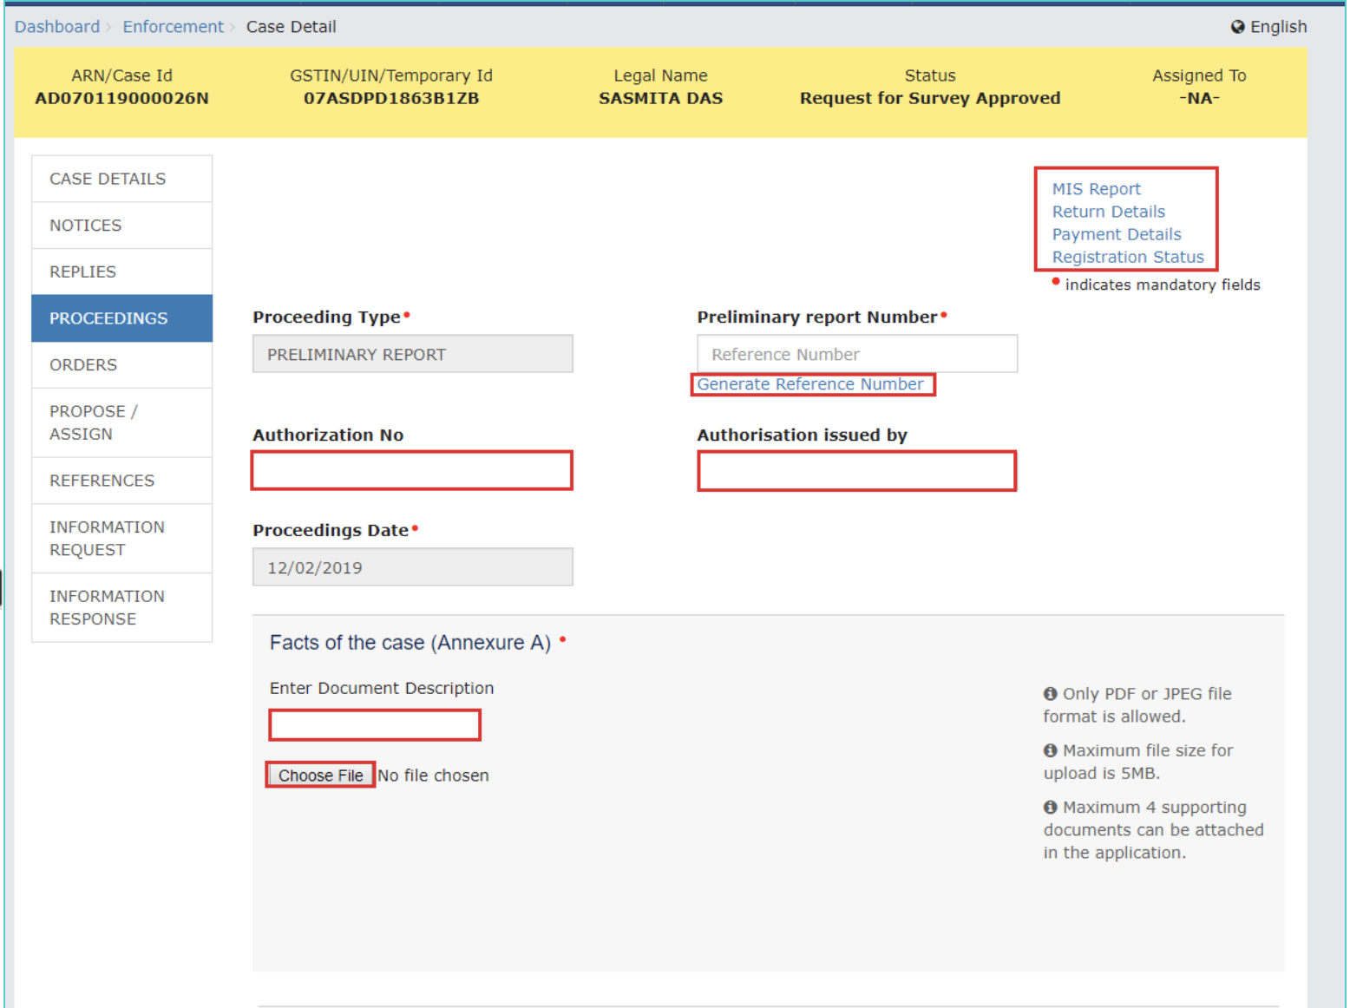
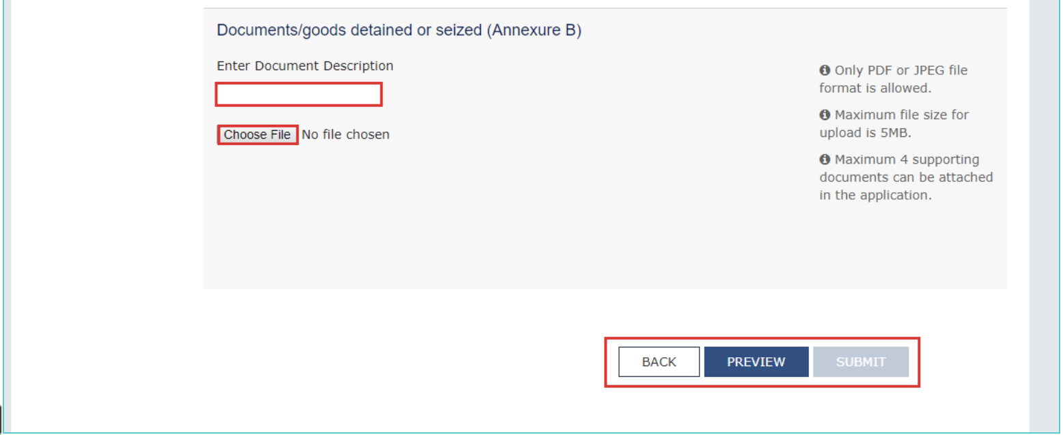
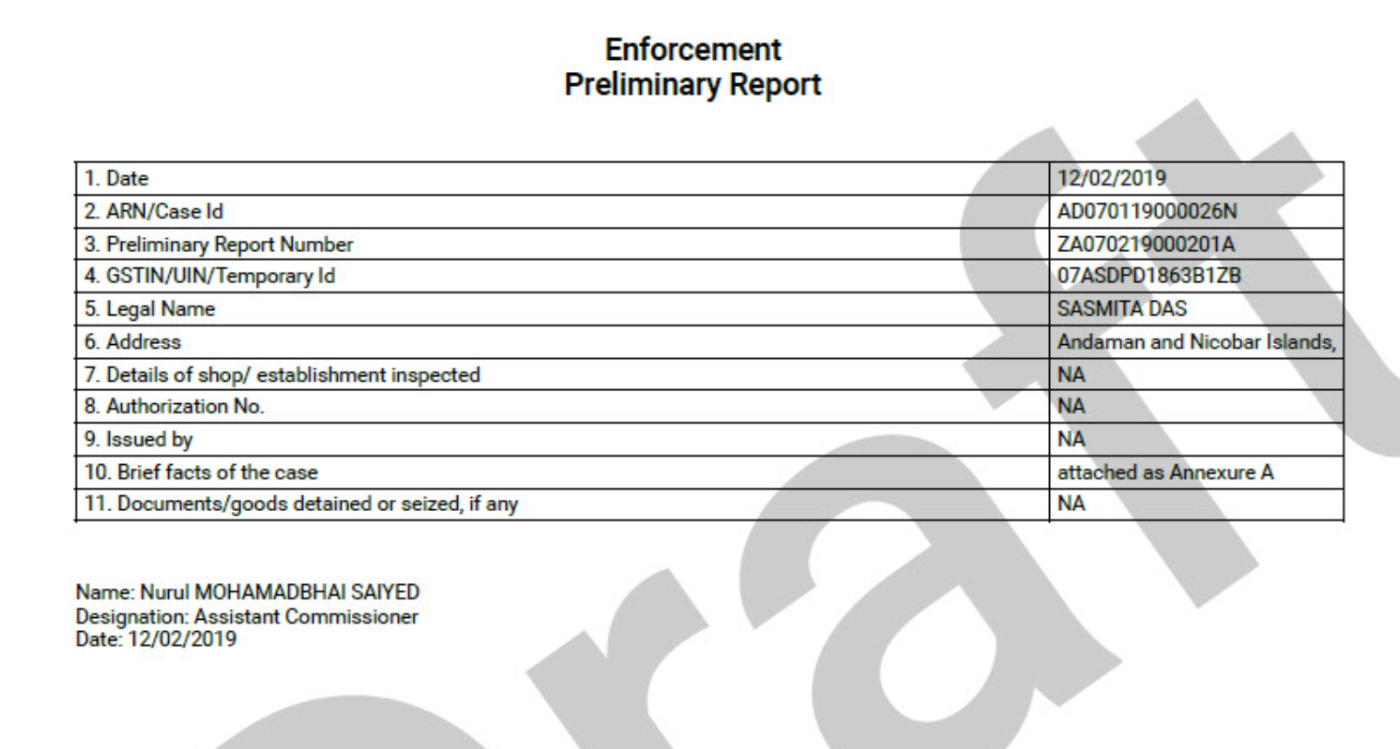
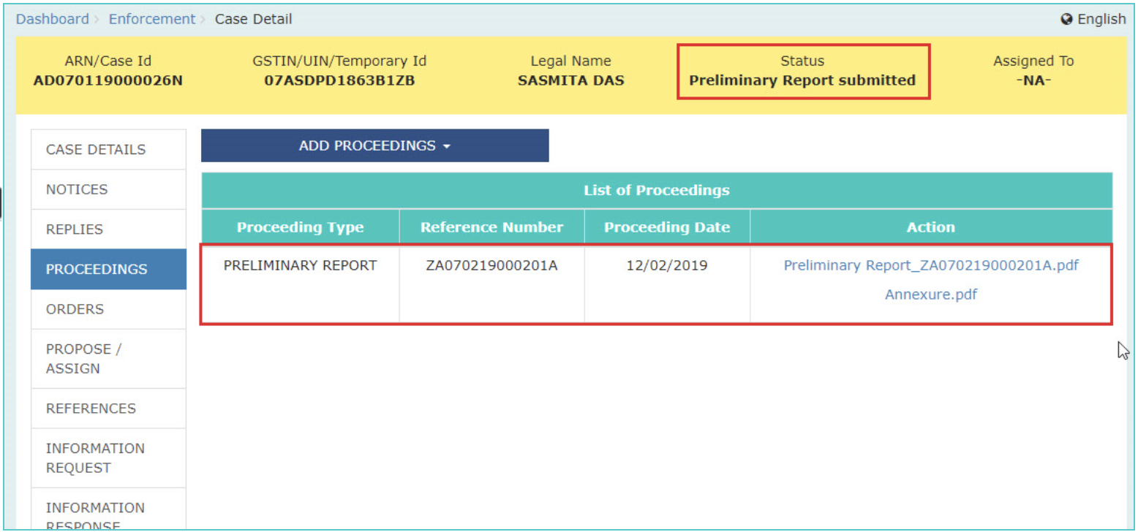
Upload Preliminary Report
Developed and Designed
by GSTN

Slide 36

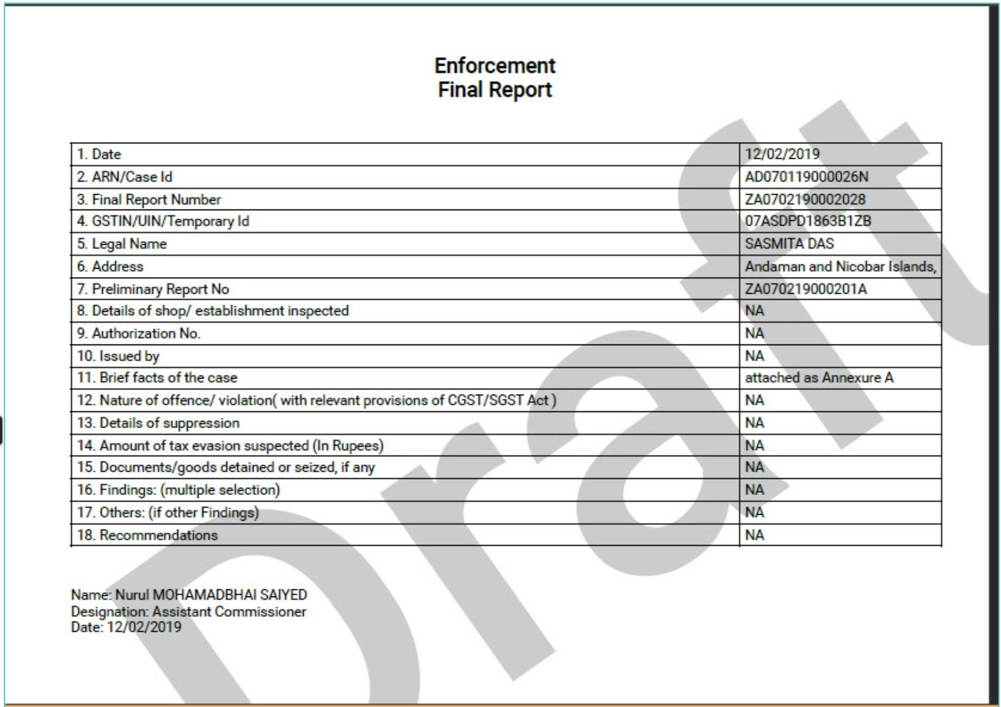
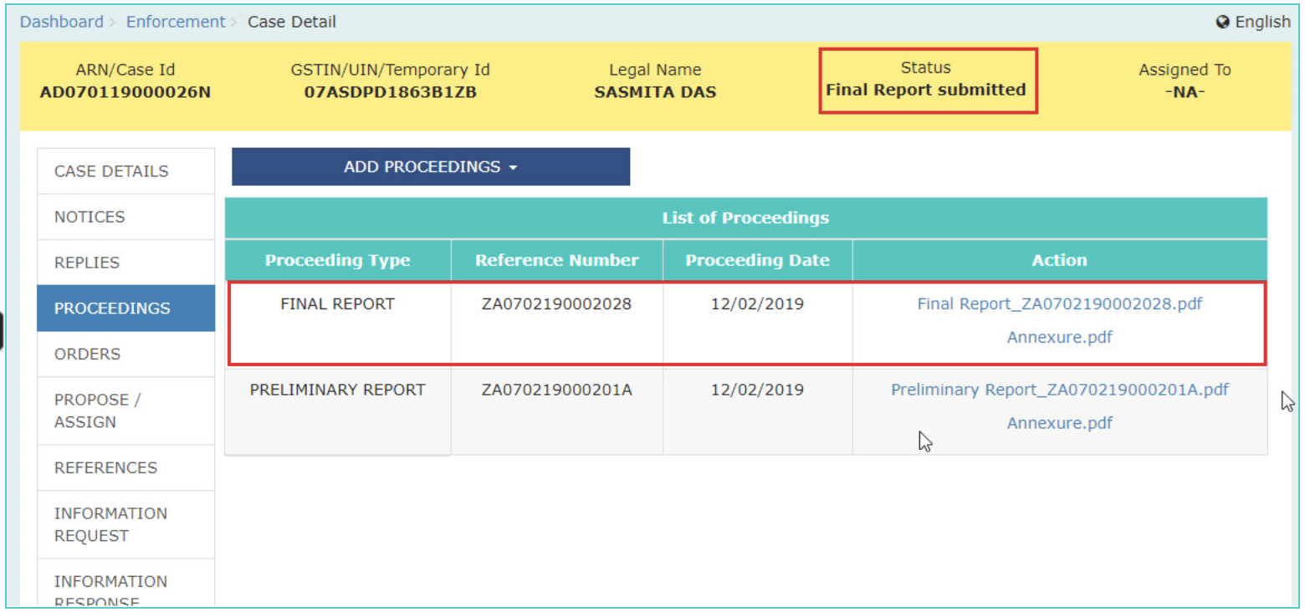
Upload Final Report
Developed and Designed
by GSTN

Slide 37
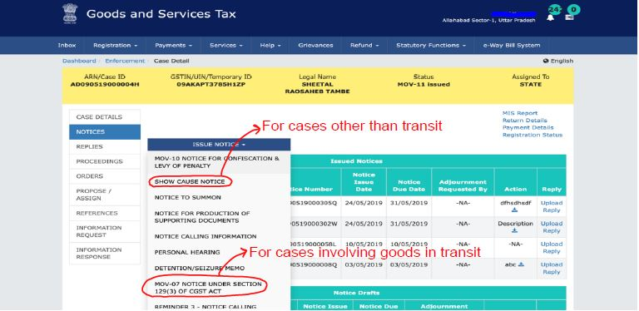
Issue of Show Cause Notice (Demand Notice)
Developed and Designed
by GSTN

Slide 38
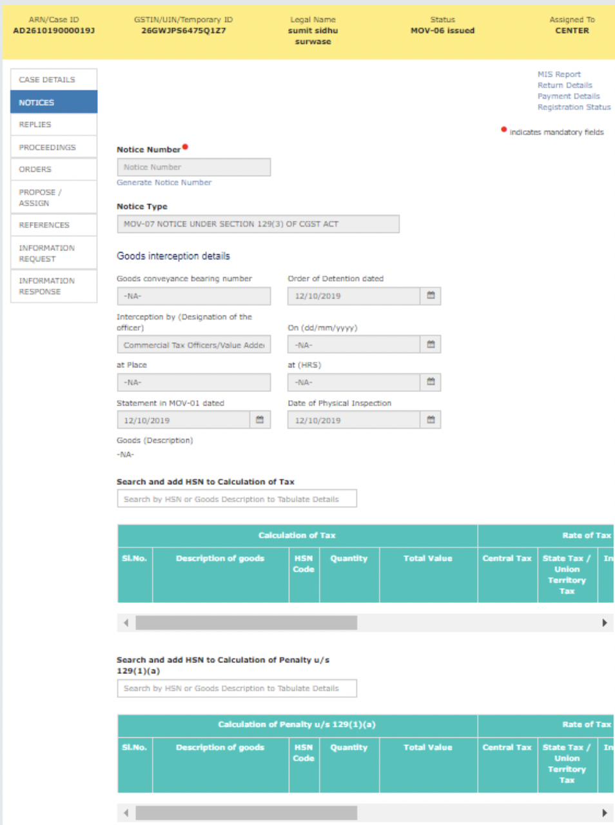
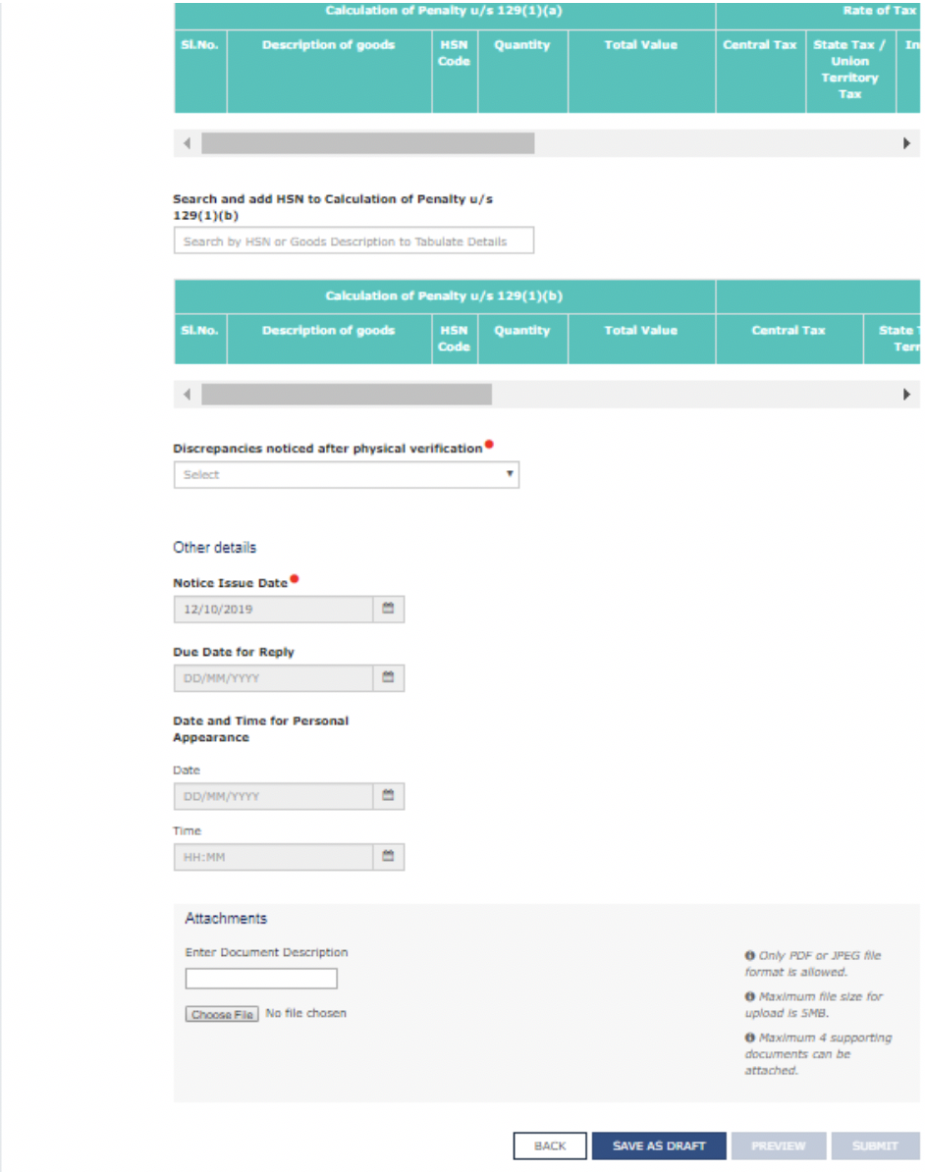
Issue of Show Cause Notice (Demand Notice) for goods in transit i.e. MOV-07
Developed and Designed
by GSTN

Slide 39
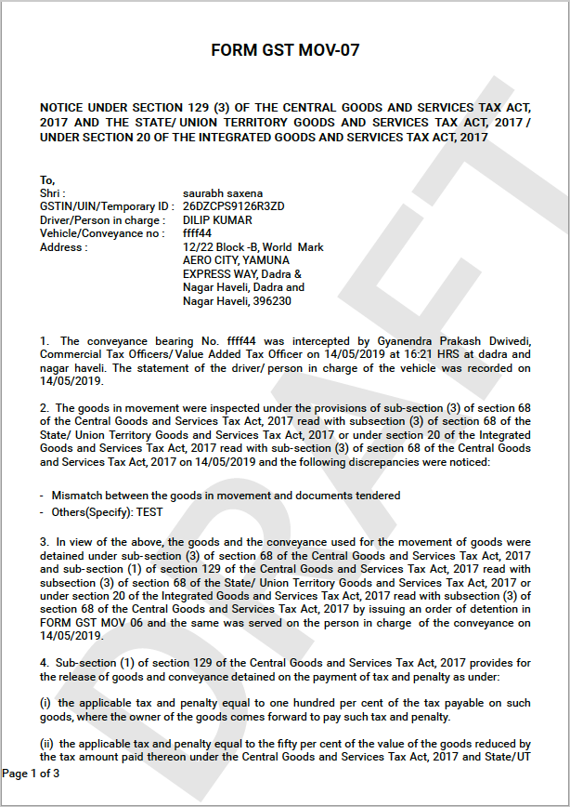
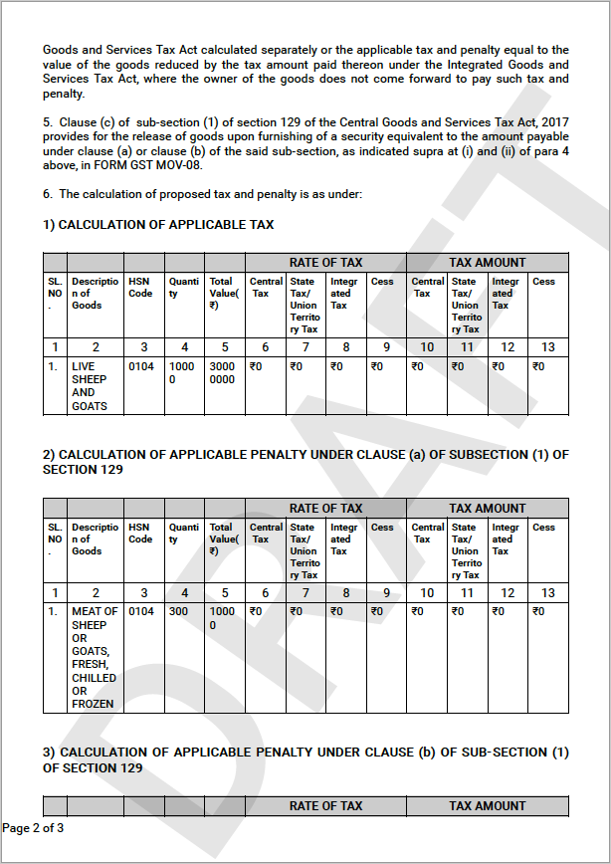
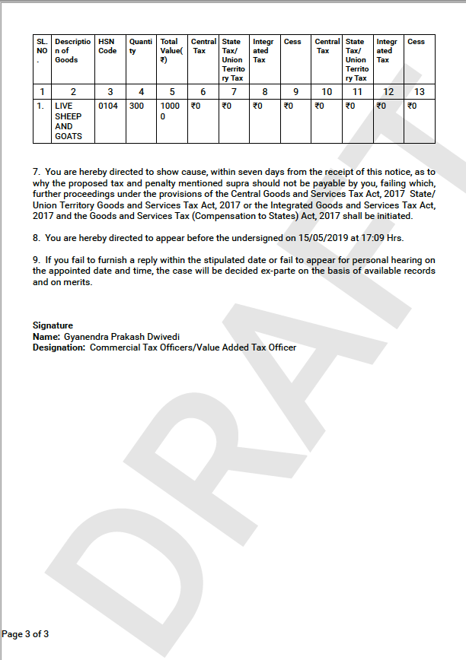
Issue of Show Cause Notice (Demand Notice) for goods in transit i.e. MOV-07 (Contd..)
Developed and Designed
by GSTN

Slide 40
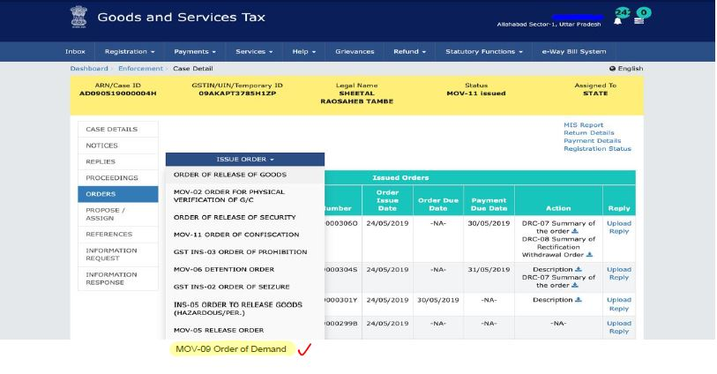
Issue of Demand Order (Confirming or dropping liability proposed in SCN)
Developed and Designed
by GSTN

Slide 41




Issue of Demand Order in case of goods in transit i.e. MOV- 09
Developed and Designed
by GSTN

Slide 42


Issue of Demand Order in case of goods in transit i.e. MOV- 09
Developed and Designed
by GSTN

Slide 43


Issue of Demand Order in case of goods in transit i.e. MOV- 09
Developed and Designed
by GSTN

Slide 44


Issue of Demand Order in case of goods in transit i.e. MOV- 09
Developed and Designed
by GSTN

Slide 45

Assign for Adjudication
A case can be forwarded to Assessment Officer for Adjudication of non-Transit Cases:
Developed and Designed
by GSTN

Slide 46

Closure of Case
Developed and Designed
by GSTN

Slide 47
Other Ancillary Processes in Case handling
Developed and Designed
by GSTN

Slide 48

Assigning Case to other Enforcement Officer
Developed and Designed
by GSTN

Slide 49

Transferring Enforcement Case to other Module/Wing
Developed and Designed
by GSTN

Slide 50

Acting upon Cases referred from Other Modules
Developed and Designed
by GSTN

Slide 51
Taxpayer’s Interface
Developed and Designed
by GSTN

Slide 52

Taxpayer’s screen to access notices/orders issued and give reply
Developed and Designed
by GSTN

Slide 53

Thank You!
Developed and Designed
by GSTN

